Slide 1

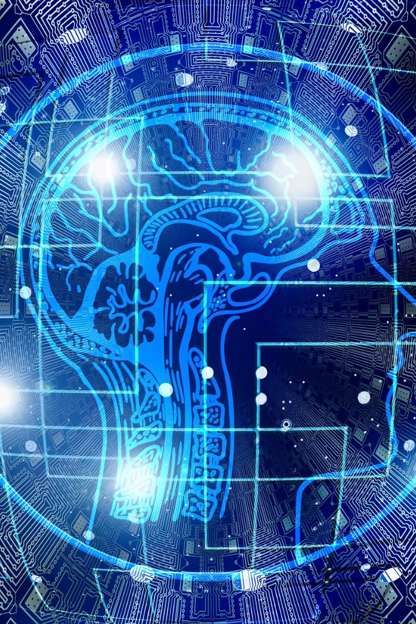

AI and Its Types
Artificial Intelligence (AI) involves the development of computer systems capable of performing tasks that require human intelligence, such as learning, understanding natural language, pattern recognition, problem-solving, and decision-making. There are two main types of AI: Narrow AI (Weak AI) and Artificial General Intelligence (AGI). AI can also be categorized based on functionality into Machine Learning (ML), Natural Language Processing (NLP), Computer Vision, Robotics, and Expert Systems.

Slide 2

AI Chatbots
AI chatbots are computer programs that simulate conversation with human users. They use Natural Language Processing (NLP) and Machine Learning (ML) to understand user input, recognize patterns, and generate appropriate responses. Chatbots offer features such as intent recognition, context awareness, multi-turn conversations, and task automation. With applications in customer support, e-commerce, healthcare, finance, and more, chatbots provide businesses with a scalable way to engage with users and streamline processes.

Slide 3
Creating an AI Chatbot
1. Define Purpose and Scope
2. Choose a Development Platform
Clearly define the chatbot's purpose, tasks, target audience, and capabilities to ensure it meets users' needs.
Select a development platform or framework, such as NLP APIs or bot frameworks, for building the chatbot.
3. Design Conversational Flow
4. Build the Chatbot
Develop the chatbot using the chosen platform, creating conversation scripts and implementing response logic.
Plan the chatbot's conversational flow, defining user intents, dialogues, and response logic for a smooth user experience.

Slide 4
Creating an AI Chatbot (contd.)
5. Integrate NLP
6. Implement Backend Integration
Integrate Natural Language Processing (NLP) capabilities into the chatbot to accurately interpret and respond to user messages.
If needed, implement backend integration to connect the chatbot with external systems or databases for additional functionality.
7. Testing
8. Deployment
Thoroughly test the chatbot's responses, scenarios, and fix any bugs or issues to ensure a high-quality user experience.
Deploy the chatbot on desired platforms or channels for user interaction, making it easily accessible and available.

Slide 5
Creating an AI Chatbot (contd.)
9. Monitor and Optimize
10. Iterate and Enhance
Continuously monitor the chatbot's performance, collect user feedback, and optimize its responses and capabilities to enhance the user experience.
Iterate on the chatbot based on user feedback and evolving requirements, introducing new features and improving existing capabilities.
11. Security Considerations
12. User Training and Documentation
Implement security measures to protect user data and ensure secure communication between the chatbot and users.
Provide user training and create documentation to assist users in effectively interacting with the chatbot and its features.

Slide 6
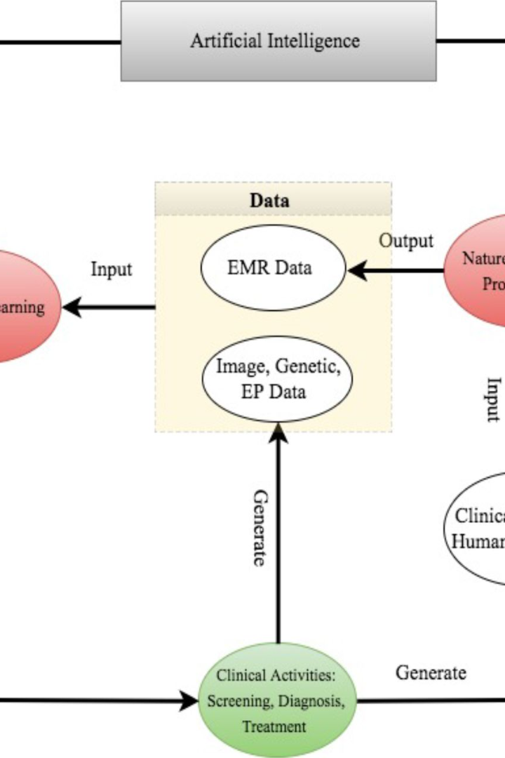
AI in Healthcare
Artificial Intelligence (AI) is transforming the healthcare industry by improving diagnostics, treatment planning, and patient care. AI-powered tools help medical professionals analyze large amounts of medical data, assist in disease detection, and provide personalized treatment recommendations. With its potential to enhance accuracy and efficiency, AI is revolutionizing radiology, drug discovery, genomics, and telemedicine, ultimately leading to better patient outcomes and improved healthcare delivery.

Slide 7

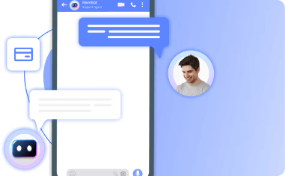
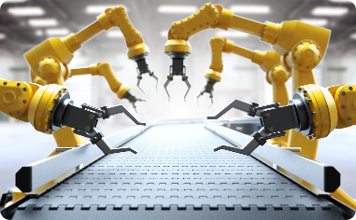
AI in Finance
Financial Data Analytics
Virtual Assistants
Robotic Process Automation
AI chatbots are utilized in the finance industry to provide personalized financial advice to customers, assist with financial transactions, and address customer queries.
AI is used to analyze complex financial data, identify patterns, and make predictions, aiding in risk assessment, fraud detection, and investment strategies.
AI-powered robots automate repetitive tasks in finance, such as data entry, reconciliation, and report generation, improving efficiency and reducing errors.

Slide 8

AI in Education
1
Personalized Learning
AI-based educational platforms provide personalized learning experiences, adapting content and pacing to individual student needs, improving engagement and outcomes.
2
Intelligent Tutoring Systems
AI tutors utilize adaptive algorithms to provide personalized feedback, guidance, and support to students, enhancing their learning journey.
3
Automated Grading
AI systems can automate grading of assignments and tests, freeing up teachers' time and providing efficient and consistent evaluations.

Slide 9

AI in Entertainment
1
Recommendation Systems
AI algorithms power content recommendation systems in streaming platforms, suggesting personalized movies, shows, and music based on user preferences and behavior.
2
Virtual Reality (VR)
AI is used in VR applications to create realistic virtual environments, enabling immersive gaming experiences, interactive storytelling, and virtual simulations.
3
Character Animation
AI techniques play a crucial role in generating realistic character animations in video games and animated movies, enhancing visual quality and realism.

Slide 10
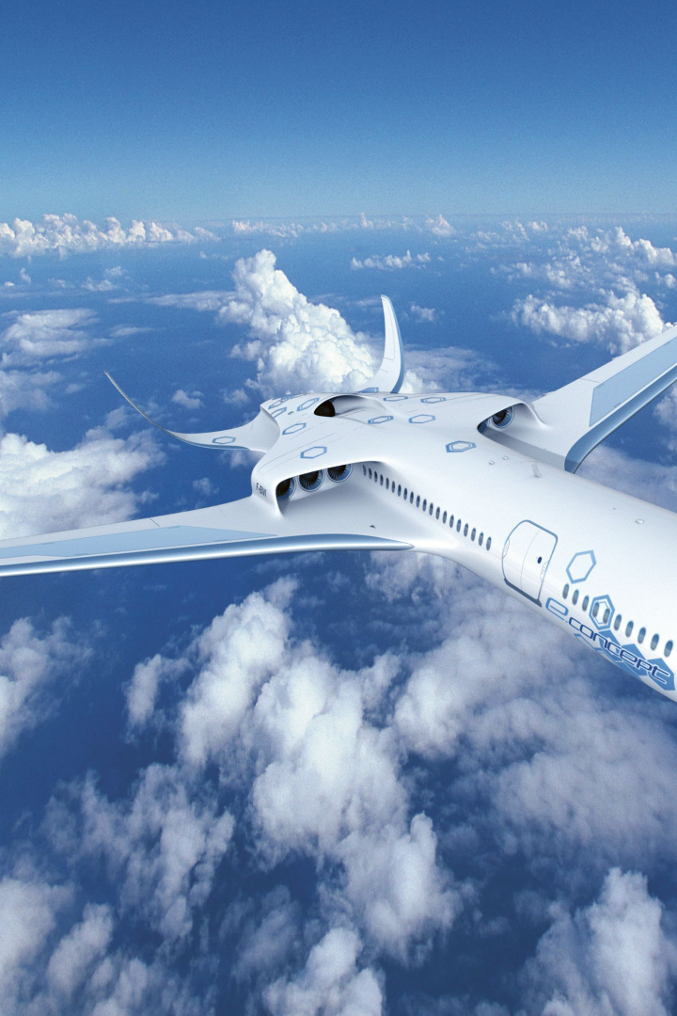
The Future of AI
The future of AI holds immense potential. Advancements in machine learning, robotics, and natural language processing will drive the development of more intelligent and human-like AI systems. Ethical considerations, responsible development, and addressing potential societal impacts will become crucial. As AI continues to evolve, it will reshape industries, redefine work processes, and pave the way for new innovations, all aimed at improving human lives.

